Slide 1

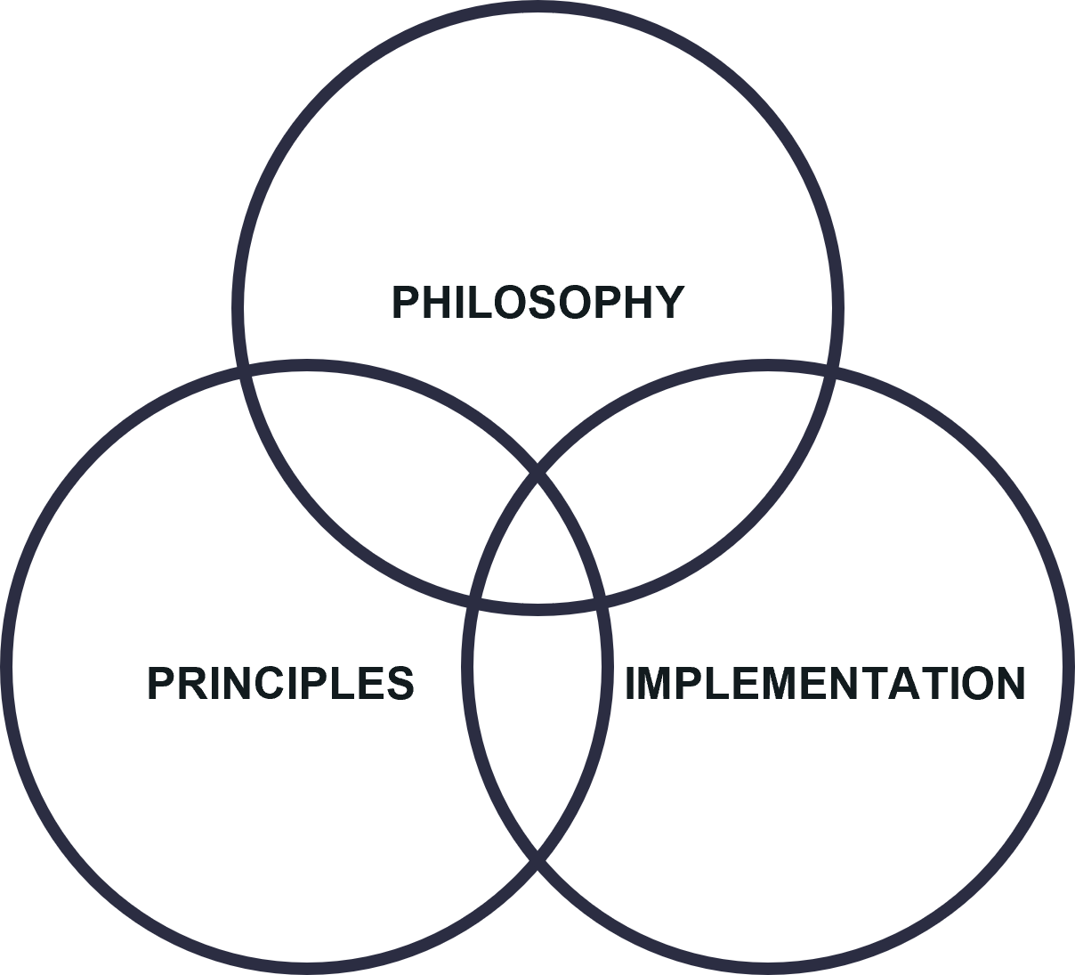
Evaluating the Relevance of the IDP
Group A2
Kevin Thabethe 1505416
Ayakha Mgaga 2472790
Nqobile Sithole 2453994
Lisa Mvelase 2453365
Sisanda Zulu 2431473

Slide 2
Contextualising the IDP
First Rounds of the
Integrated Development Plan
Developmental Facilitation Act, 1995
Local Government Transition Second Amendment Act, 1996
1996
Democratic Transition
Rhetorical to Practical
Municipal Systems Act No.32
2000
(Harrison et. al, 2008; Sowman, 2006)
Objectives of the IDP
Locally Informed Budgeting
Multi-Sectorial Development
Integrated and Coordinated System
Requires accountability and public participation to ensure effective optimal use of available resources
Facilitates coordination and cooperation horizontally and vertically
Tool for transformative planning and decision-making processes in local government
(Ruwanza, 2016)

Slide 3
Principles of IDP?
_{Social Justice}
_{Equity}
Participation
Integration
Co-operation
and
Coordination
Decentralisation
(Harrison et. al, 2008; Sowman, 2006)

Slide 4

Critiquing the IDP (Flaws/ Room to Grow)
_{Planning systems}
_{Efficiencies of municipalities}
_{Political Agenda}
Failure in service delivery and overturning Apartheid spatial structures
The gap between policy and Practice
Environmental management and sustainable development
(Coetzee, 2012; Harrison et. al, 2008; Sowman, 2006; Ruwanza, 2016 )

Slide 5
Why has the IDP continued to serve as the central form of municipal planning in South Africa?
_{Still a work in progress}
(Harrison et. al, 2008)
_{Adaptability}
_{Proximity to the people}
_{Environmental Sustainability}
A holistic and collaborative approach
(Harrison et. al, 2008)

Slide 6
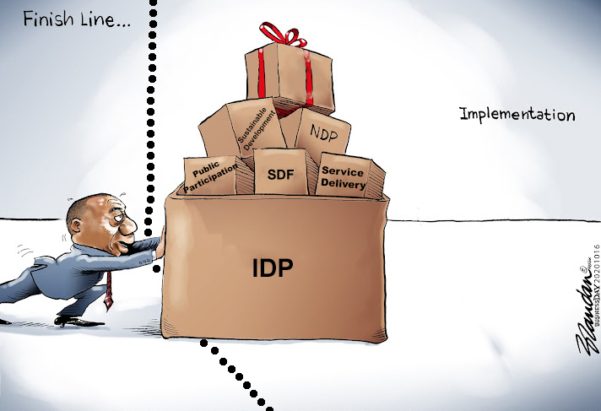

CONCLUSION
1995
Ready,
Set,
Gooooooo!!!

Slide 7
THE END

Slide 8
Reference list
Coetzee, J. (2012) The transformation of municipal development planning in South Africa (post-1994): impressions and impasse, Town and Regional Planning, 61
Harrison, P., Todes, A. and Watson, V. (2008) Chapter 4: Planning and local governance, in Harrison, P., Todes, A. and Watson, V. (eds) Planning and transformation. Learning from the post-apartheid experience, London: Routledge
Ruwanza, S. and Shackleton, C.M. (2016) Incorporation of environmental issues in South Africa’s municipal Integrated Development Plans, International Journal of Sustainable Development & World Ecology, Vol. 23, No. 1, 28–39
Sowman, M. and Brown, A.L. (2006) Mainstreaming environmental sustainability into South Africa's integrated development planning process, Journal of Environmental Planning and Management, Vol. 49, No. 5, 695 – 712, September 2006

